Slide 1
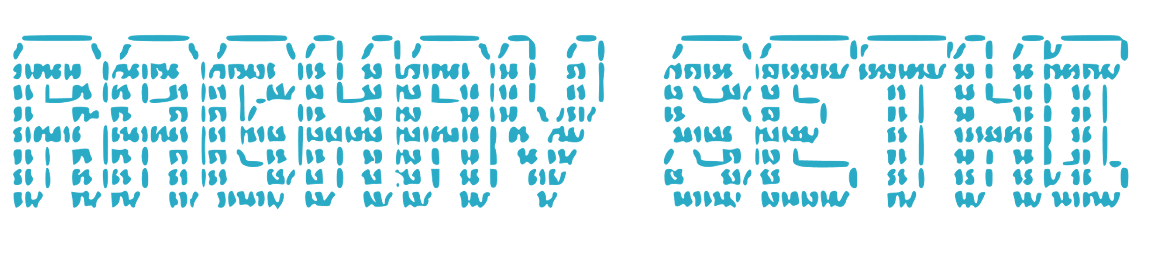

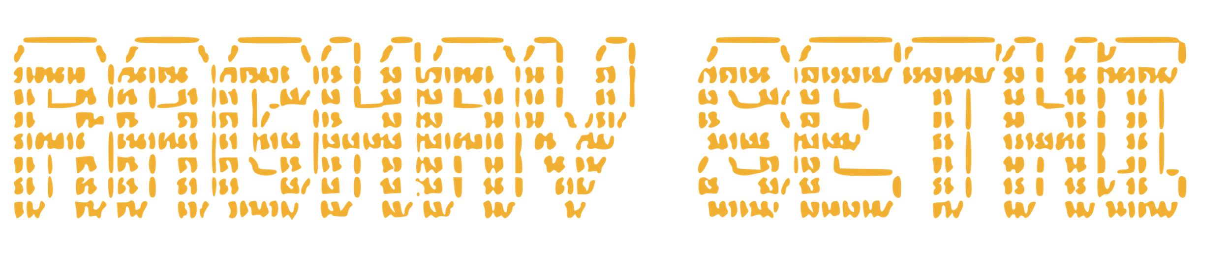


Slide 2

ERROR
CHECK THE DATA IS OF CORRECT FORMAT
CHECK THE VALUES ARE CORRECT
CHECK ALL REQUIRED INFORMATION IS GIVEN
OK

Slide 3
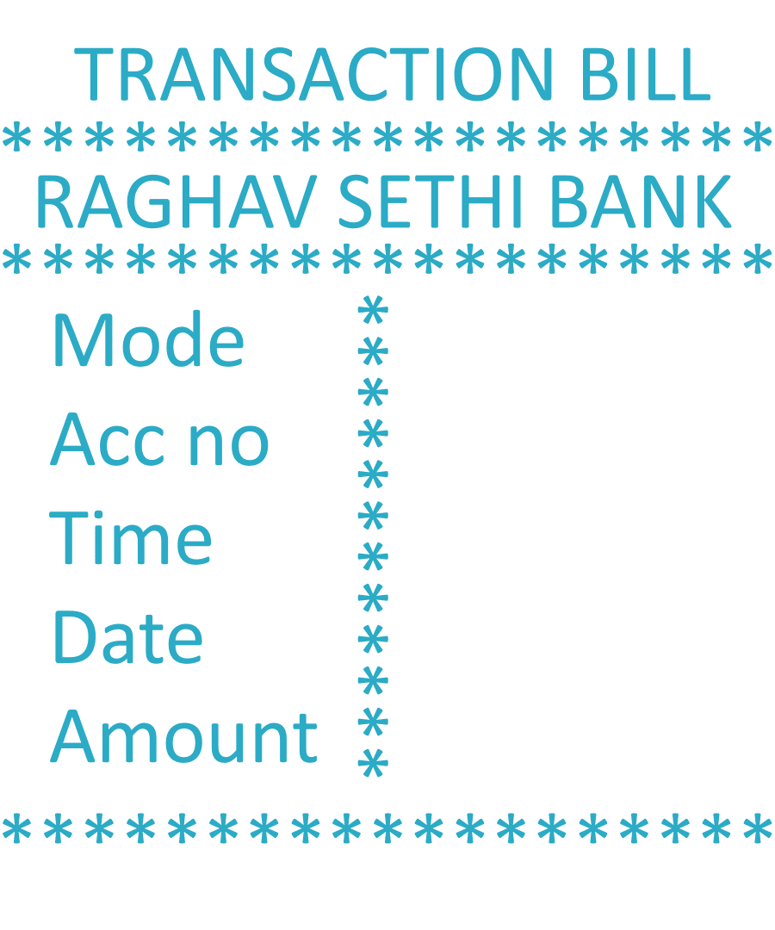
TRANSACTION BILL
*******************
RAGHAV SETHI BANK
*******************
Mode
Acc no
Time
Date
Amount
************
*******************

Slide 5








Create acc
delete acc
edit acc
View acc
widraw acc
Deposit acc

Slide 6


Slide 7
view
Profile 1
Edit
view
Profile 2
Edit

Slide 8

Acc no.
Name
Birthdate
Number
State & Fax
Address
Password
Create

Slide 9
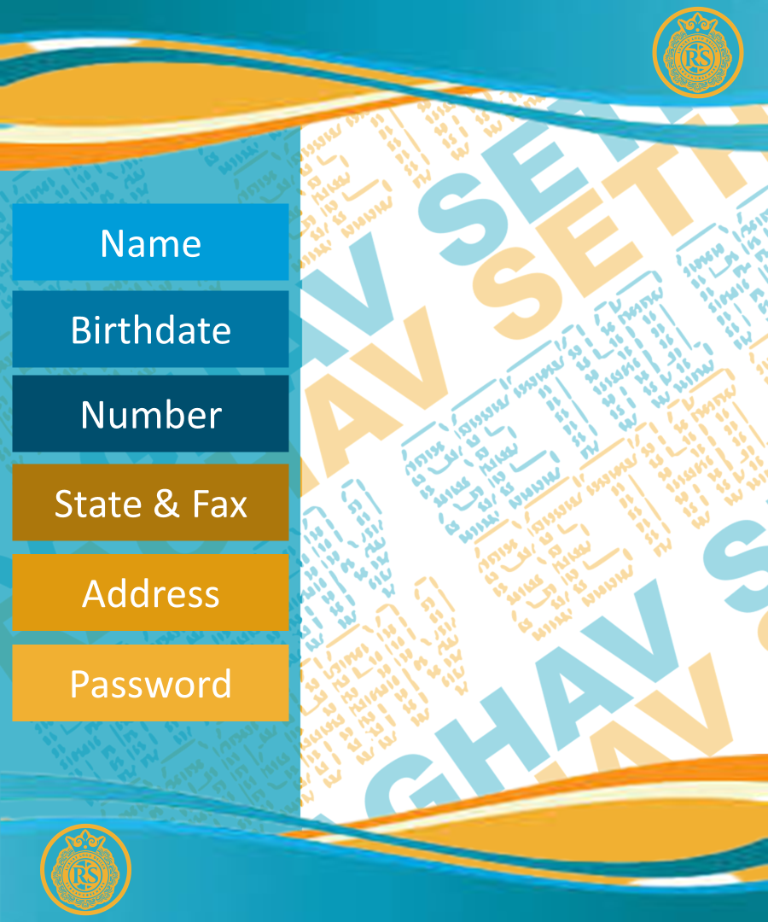
Name
Birthdate
Number
State & Fax
Address
Password

Slide 10
Authorize
Acc no.
Password
Enter

Slide 11
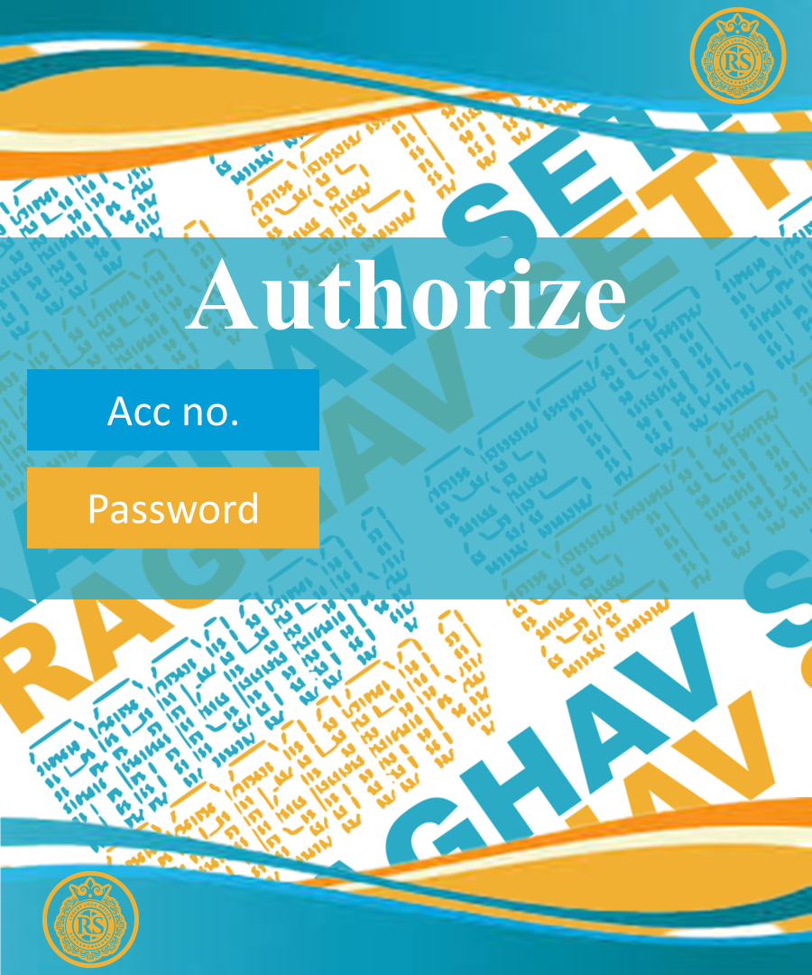
Authorize
Acc no.
Password

Slide 12
Delete
Acc no.
Password
Enter

Slide 13
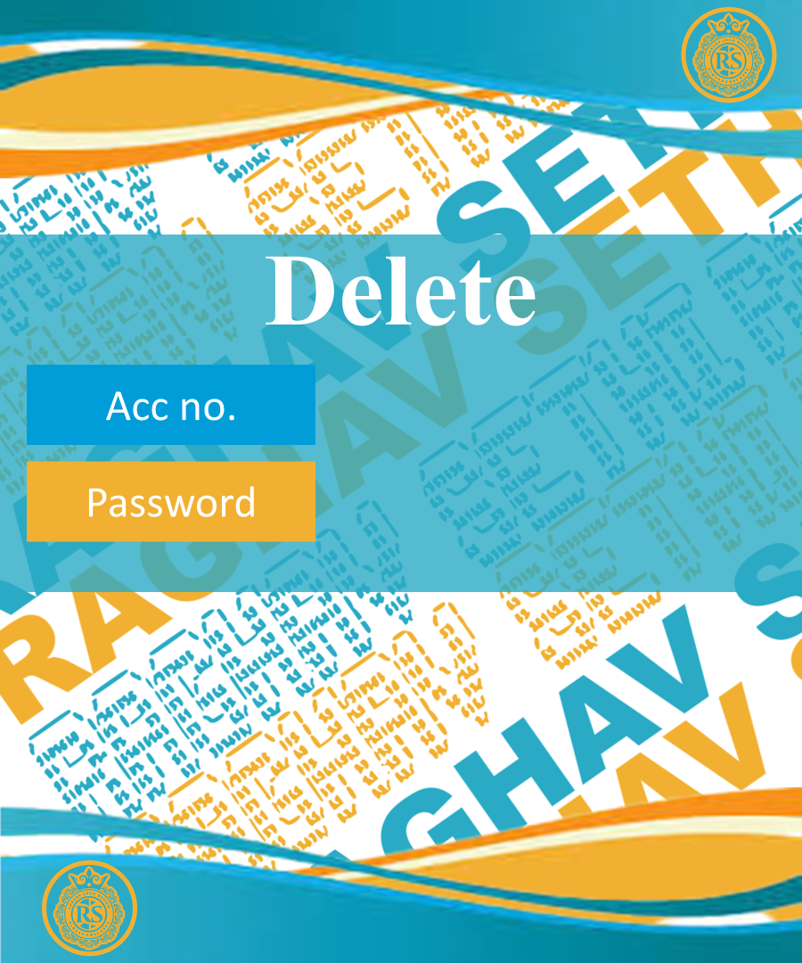
Delete
Acc no.
Password

Slide 14
Widraw
Amount
Account no.
Password
Continew

Slide 15
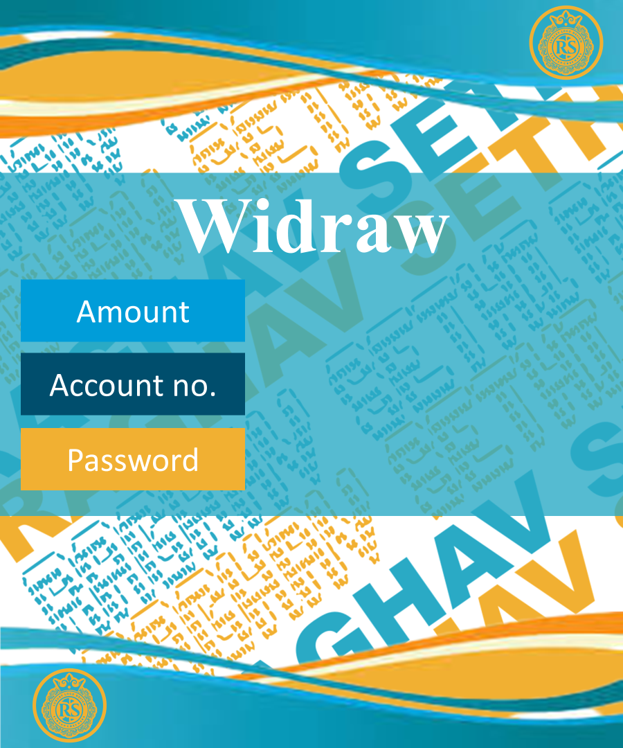
Widraw
Amount
Account no.
Password

Slide 16
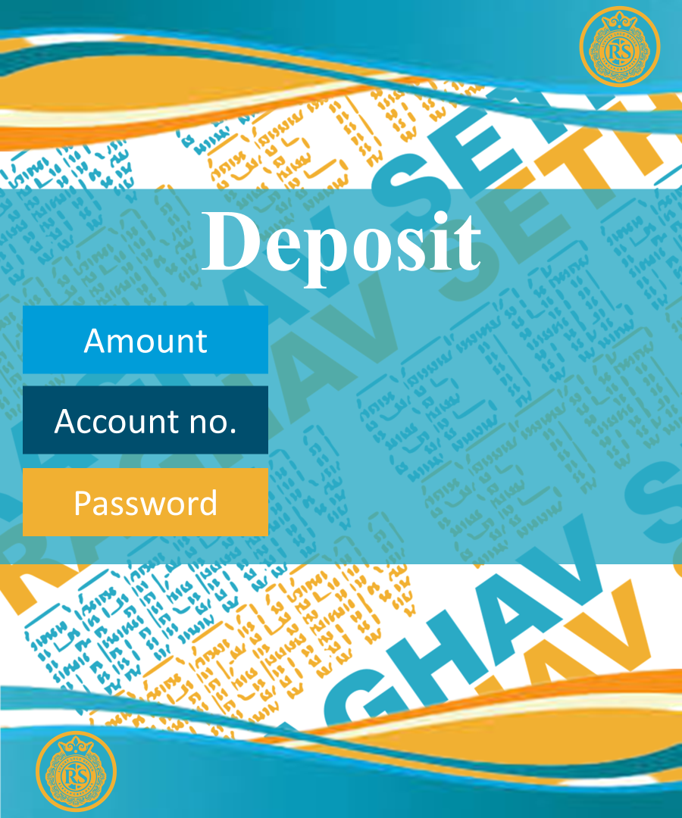
Deposit
Amount
Account no.
Password

Slide 17
Acc no.
Name
Birthdate
Number
State & Fax
Address
Password
Edit

Slide 18



